Slide 1
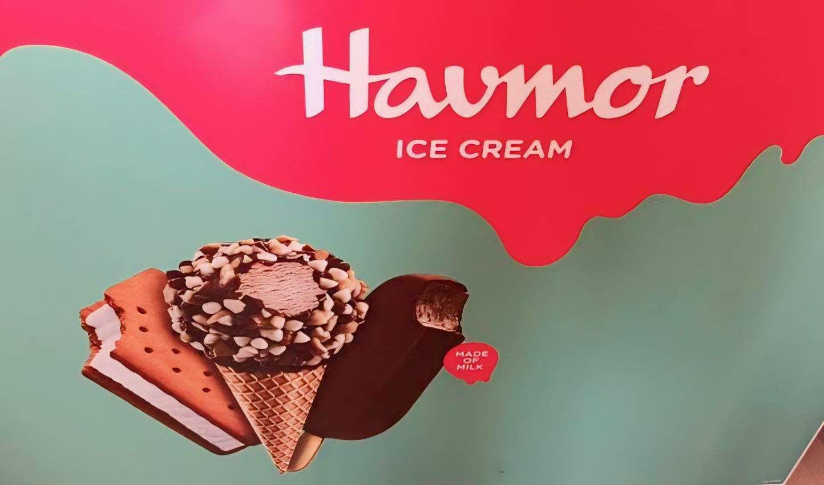
DR. Lankapalli Bullayya Degree & PG College
Team Leader : A.Venu kumari
1. B.Prasad
2. A.Sai
3. A.Jagadesh
4. A.Praveen kumar
5. A.Venu kumari

Slide 2
INDEX
Part 1: Brand study, Competitor Analysis& Buyer’/Audience’s Personal
Part 2: SEO & Keyword Research
Part 3: Content Ideas and Marketing Startegies
Part 4: Content Creation and Curation (Post Creations,designs/Video Editing, Ad Campaigns Over Social Media and Email ideation and Creation

Slide 3
Part 1: Brand study, Competitor Analysis &Buyers/Audience’s persona
Research Brand:
Misssion/Values : Havmor’s mission could be something like “To delight our customers with irresistible ice cream experiences that bring joy to every moment.”
USP: Unique Selling Proposition, and Havmor is an ice cream brand. so, the USP of Havmor could be its range of unique.
Analyze Brand Tone and Identity : Havmor, an Indian ice cream brand, often adopts a friendly and approachable tone in its communication, reflecting its commitment to creating delightful experiences for its customers.

Slide 4
Brand study (Mission/Values & USP)
Mission & Values: Havmor’s mission could be something like “To delight our customers with irresistible ice cream experiences that bring joy to every moment .
Clean: “Clean Havmor” sounds like it could refer to ensuring cleanliness at Havmor, which could be a company, a place, or a brand.
Kind: “kind Havmor” sounds like a charming name! Is it for a business, a project or something else entirely.
Effective: The marketing havmor the Indian ice cream brand more effective. If so, enhancing and marketing strategies, expanding product lines and focusing on customer experience could be key.
Unique Selling Proposition(USP)Analysis: Havmor known for its quality ice cream, could have a unique selling proposition (USP) analysis focusing on its diverse range of flavors, use of natural ingredients, and possibly its commitment to sustainability, depending on their brand positioning. It could highlight how it stands out from competitors emphasizing freshness, variety, or unique flavor combinations.

Slide 5
Brand Study (Brand Tone &KPI)
Brand Tone: Havmor’s brand tone is often vibrant, friendly, and inviting, reflecting its focus on delivering delicious ice cream experinces. It resonates with warmth, nostalgia, and the joy of indulging in tasty treats they ofter emphasize quality ingredients, innovation, and the joy of indulging in their delicious treats.
Havmor’s KPIs may include: Havmor’s Key Performance Indicators (KPIs) could include metrics like revenue growth, market, share, customer product performance, and employee engagement.
Sales growth: Havmor sales growth typically look at the percentage increase or decrease in their revenue or annually.
Customer satisfaction: The satisfactions Havmor ice cream, you could look for online reviews, customer feedback on social media platforms and ratings on review wedsites.
Brand awareness: Introducing Havmor Ice Creams where every scoop is a taste of pure delight. Indulge in our creamy, Iuscious flavors crafted with passion and expertise.
Market share: As of my last update Havmor an Indian ice cream brand held a significant market share in certain regions of India particularly in Gujarat and parts of North India.

Slide 6
Buyer/Audience Persona
Name: vijay
Age: 26
Gender: Male
Occupation: software
Income: 3-4LPA
Psychographics:
Values: Havmor Ice creams , as a brand , focuses on quality
Interests:Havmor is an Indian ice cream brand knows for its wide range of flavors
Personality: If Havmor had a personality , it might be described as vibrant and induigent
Behavior: Havmor ice cream behaves as a delightful treat , offering moment
Shopping habits: shopping habits can vary alot from person to person, some people prefers to shop online
Social media usage:Havmor ice creams to social media usage is interesting, both can be indulgent in their own ways
Goals : As a busy professional she seeks brands that offer easy access to their products through online platforms or local stores saving her time and effort in purchasing.
Challenges:
Managing limitations due to health allergic and ethics.
Minimizing waste while experiencing new recipes.
Findings genuine experiences in mindsit of global food trends.
Accessing exoticing redients or specially foods.
Balancing expenses with dictary expioration.

Slide 7
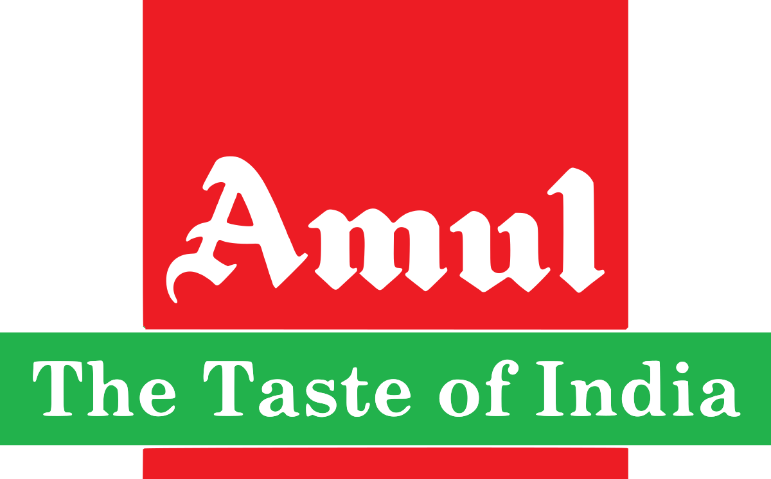
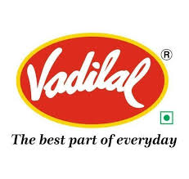

Part 1: Brand study, Competitor Analysis & Buyer’s/Audience’s Persona
Competitor Analysis: Havmor emphasizes the use of premium ingredients to create delicious and flavorful ice creams. The focus on quality ensures a consistenly satisfying taste experience for consumers.
- AMUL:Analyzing Amul’s competitor provides valuable insights into the dairy industry landscape. Here’s a brief competitor analysis each competitor brings unique strengths and strategies to the table.
-vadilal:Vadilal’s USP lies in its commitment to quaility, innovation and a wide range of ice cream flavors that Cater to diverse tastes. They have a rich legacy of crafting delicious frozen treats, making them a trusted choice for ice cream lovers.
-Kawality wall’s:kwality wall’s has a rich heritage and legacy in theice cream industry, dating back to 1956. the long standing presence and experience contribute to its brand trust and recognition.

Slide 8
Part1: Brand study, Competitor Analysis & buyer’s/Audience’s persona
Competitor 1: Amul’s USP revolves around its cooperative structure, which involves millions of farmers across India. They emphasize their commitment to providing high-quality diary products at affordable prices leveraging their vast network of suppliers.
Online communication: Amul has recognized the importance of online communication and has been actively engaging platforms. They use social media channels such as facebook, Twitter, and Instagram to share product updates, promotions, and engage with their audience.

Slide 9
SWOT
Strengths:
- Brand Recognition: It’s one of India’s most recognizable brands, known for its quality dairy products.
-Market Penetration: It has a strong presence across India, reaching both urban and rural markets effectively through its distribution channels.
- Customer loyality : Due to its consistent quality and affordability, Amul has a loyal customer base that trusts its products.
WEAKNESS:
Quality Consistency: Some consumers mention issues with consistency in product quality, like variations in taste or texture in different batches.
- Packaging Concerns: There have been occasional complaints about packaging quality, such as leakages or damages during transportation.
- Availability: In some regions or during peak demand periods, there might be challenges in finding certain Amul products, leading to customer dissatisfaction.

Slide 10
SWOT
Opportunities : Amul, the dairy cooperative, has various opportunities for growth and expansion. They could focus on diversifying their product range , expanding into new markets. domestically or internationally.
THERATS:
Competition intense competition from domestic and international dairy companies could impact market share and pricing strategies
Price fluctuations in raw material prices, especially milk can affect profitability
Regulatory challenges in government regulations or policies related to the dairy industry can pose challenges for operation and expansion plans.

Slide 11
Competitor 2:
USP: Vadilal’s USP lies in its commitment to quaility,
innovation and a wide range of ice cream flavors that
Cater to diverse tastes. They have a rich legacy of crafting delicious frozen treats, making them a trusted choice for ice cream lovers.
ONLINE COMMUNICATION:Vadilal communicates with its customers through various channels, including social media platforms like facebook, instagram and twitter. They use these platforms to share updates about their products, promotions, events and engage with their audience through contests, polls and interactive content.

Slide 12
SWOT
Strengths:
-Established brand vadilal is a well known brand in the icecream industry with a long history dating back to 1907
-Diverse product range vadilal offers a wide variety of icecream flavors and products catering to different tastes and preferences
-Strong distribution network the company has a widespread distribution network, enabling it to reach customers a cross various regions.
Weakness:
-Regional concentration while Vadilal has a strong presence in certain regions of india , it may lack nationwide penetration comoared to some competitors.
-Pricing in a price sensitive market, the premium pricing of Vadilal’s products may limit accessibility to a certain segment of consumers.
-Dependence on seasonal demand ice creams sales are often seasonal, which can lead to fluctuations in revenue and profitability.

Slide 13
SWOT
Opportunities:
-Health and wellness trends with the growing focus on health-conscious eating, Vadilal can explore opportunities in low sugar low-fat, or healthier ice cream options.
Export markets expanding into international markets can provide new revenue streams and global brand recognition.
Online sales increasing online presence and e-commerce initiatives can tap into the growing trend of online grocery shopping and direct to consumer sales
Threats:
-Intense competitions Vadilal faces competition from both domestic and internation ice cream brands, leading to prices wars and market share battles.
-Changing consumers preference shifts in comsumers preferences towards healthier or alternative dessert options could impact traditional ice creams sales.
-Regulatory changes in food safety regulations or taxation policies can affect production costs and profitability.

Slide 14
Competitor 3:
USP : kwality wall’s has a rich heritage and legacy in the
ice cream industry, dating back to 1956. the long standing
presence and experience contribute to its brand trust and
recognition.
ONLINE COMMUNICATION : Refers to the exchange of information, messages, or platforms over the internet. This can include various forms of communication such media, video calls and more. Online communication has become increasingly important in todays digital age due to its convenience, speed and global reach. It enables individuals, business, and organizations to connect, collaborate and share information regardless of geographical distances. Online communication plays a crucial role in areas such as business operations, education, social interactions, and entertainment, facilitating seamless and efficient interactions across different devices and platforms.

Slide 15
SWOT
Strengths:
STRONG BRAND: Kawality Walls has a well –established brand known for quality ice cream products.
WIDE PRODUCT RANGE: They offer a diverse range of ice cream flavors and products catering to various tastes and prefernces.
DISTRIBUTION NETWORK : They have an extensive distribution network, ensuring their products are widely available.
Weakness:
Seasonal Demand: Ice cream consumption tends to be seasonal, leading to fluctuations in sales.
Dependency on Dairy: The company’s products heavily rely on dairy, which can be a limitation for vegan or lactose- intolerant customers.
Competiton : There are numerous competitors in the ice cream market, posing a challenge to market share.

Slide 16
Opportunities:
Health Trends: Expanding into healthier or vegan options can tap into growing health- conscious consumer segments.
International Expansion: Exploring markets outside the current geographic areas can lead to new growth opportunities.
E-commerce: Leveraging e-commerce channels can reach a wider customer base and improve convenience.
Threats:
Health Regulations: Changes in health regulations regarding sugar content or ingredients can impact product formulation.
Economic conditions: Economic downturns may affect consumer spending on discretionary items like ice cream.

Slide 17
Part 2: SEO AND KEYWORDS RESEARCH
SEO AUDIT : A SEO audit is a comprehensive analysis of a website's factors affecting search engine visibility.
KEYWORD RESEARCH :Keyword research involves identifying the words and phrases people use when searching for information online, relevant to your business or content. It helps you understand what your target audience is looking for so you can optimize your content to attract more organic traffic.
ON PAGE OPTIMIZATION :META TAG OPITIMIZATION AND CONTENT OPITIMIZATION
On-page optimization refers to the process of optimizing individual web pages to rank higher and earn more relevant traffic in search engines. This involves optimizing content, HTML source code, and other on-page elements to improve visibility, relevance, and user experience. It includes tasks like optimizing meta tags, headings, images, and internal linking, as well as ensuring the content is valuable and aligned with user intent.

Slide 18
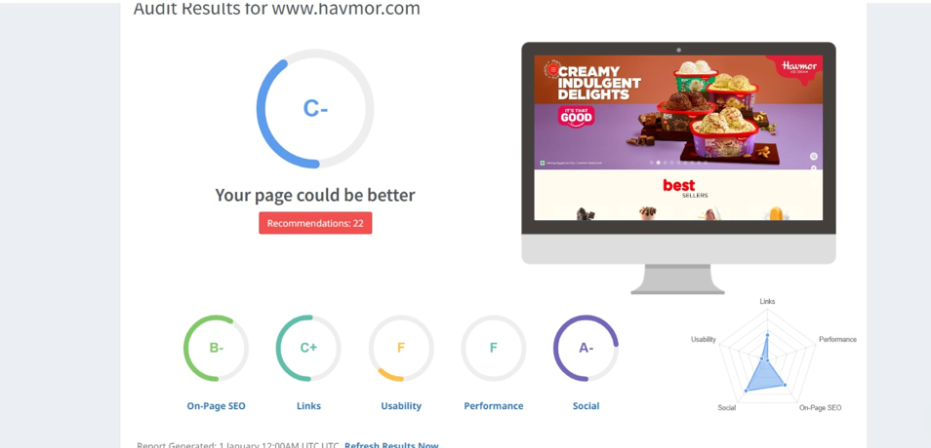
SEO AUDIT

Slide 19
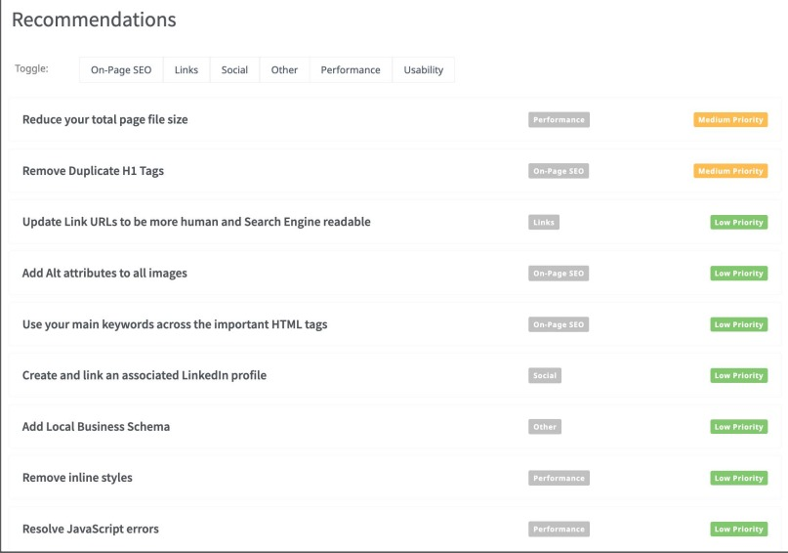
SEO AUDIT
RECOMMENDATIONS :
HERE ARE SOME POINTS OF HOW THE WEBSITE CAN IMPROVE ITS SEO
Optimise image and other assets by compressing them
use h1 for the heading
start with off page actitvites such as link building.

Slide 20
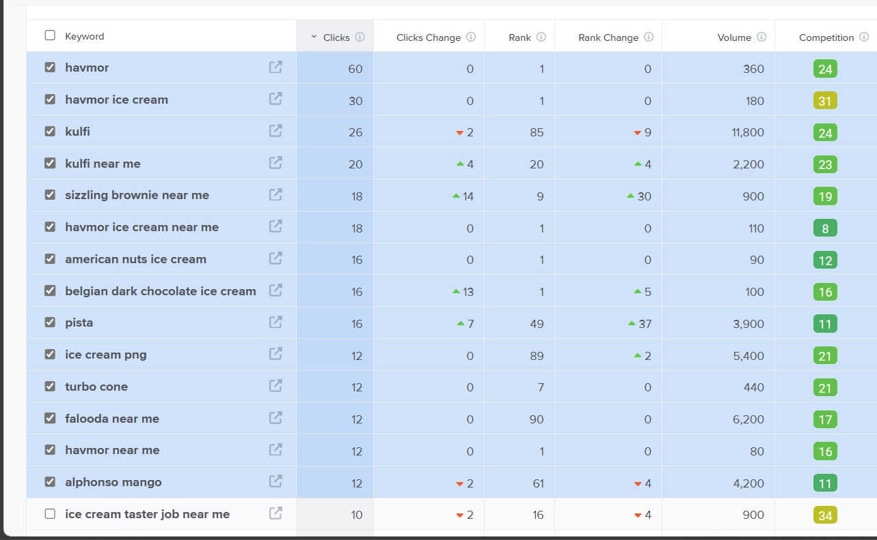
KEYWORD RESEARCH
KEYWORD OBJECTIVE : SALE ORIENTED
BLACK FOREST
SANDWICH ICE CREAM
KULFI
CHOCO BROWNIE
WE CAN USE THESE 4 AS PRIMARY KEYWORDS SINCE THEY HAVE DECENT VOLUME AND ARE RELEVANT TO THE BRANDS PRODUCTS .

Slide 21
ON PAGE OPTIMIZATION
focus keywords :Black forest, sandwich ice cream ,kulfi, choco browine
meta title : Havmor ice cream discover our delicious flavours and treats
meta discription: Havmor offering including the creamy texture of their ice cream the variety of flavours avaliable the use of premium ingredients and the overall enjoyment that comes with including in their deserts adjustment can be made to better reflect specific brand messaging or marketing objectives

Slide 22
ON PAGE OPTIMIZATION (CONTENT OPTIMIZATION)
introduction : This industry was established before our independence. Havmor is established in
karachi in1944. havmor is very popular in gujarat.
section 1: variety of flavors havmor offers a diverse selection of ice cream flavors catering to various tastes and preferences. from classic flavors like chocolate, vanilla, and strawberry to exotic options like mango, kesar pista, and black currant, there's something for everyone.
section 2: quality ingredients havmor prides itself on using high-quality ingredients to create its ice creams. they source fresh milk, cream, fruits, nuts, and other ingredients to ensure premium taste and texture in every scoop
section 3: customer experience havmor focuses on providing a delightful customer experience, whether through its vibrant ice cream parlors, convenient take-home packs, or online ordering options. they strive to create memorable moments for customers enjoying their ice creams
section 4: customer experience havmor focuses on providing a delightful customer experience, whether through its vibrant ice cream parlors, convenient take-home packs, or online ordering options. they strive to create memorable moments for customers enjoying their ice creams
conclusion : havmor ice cream, founded in india in 1944, has grown into a popular brand known for its wide range of flavors and quality products. its conclusion depends on various factors such as market trends, consumer preferences, and business strategies. without specific context, i can't provide a definitive conclusion. however, it's likely that havmor continues to innovate and adapt to remain competitive in the ice cream market.

Slide 23
Document the challenges faced during the research and analysis phase, as well as the key insights gained from the keyword research process
popular flavors : through keyword research insights into the most popular havmor ice cream flavors can be gained.
brand perception: keyword research can reveal how customers perceive the havmor brand compared to competitors monitoring branded keywords and sentiment analysis can provide actionable insights for brand reputation management.
local search trends: analyzing local search trends and location based keywords provides valuable insights into where potential customers are searching for havmor ice cream guiding local seo strategies and targeted advertising campaigns.

Slide 24
PART 3: Content Ideas and Marketing Strategies
Content Idea Generation & Strategy :
Havmor of the Month Series:Create monthly content focusing on a highlighted havmor ice cream flavor including its unique features taste profiles and pairing suggestions
Interactive Quizzes: Develop fun and interactive quizzes on social media or the website allowing customers to discover their ideal havmor ice cream flavor based on their preferences
Ice Cream DIY: Share DIY ice cream recipes using havmor products, such as homemade ice cream cakes popsicles and customized sundaes with creative toppings

Slide 25
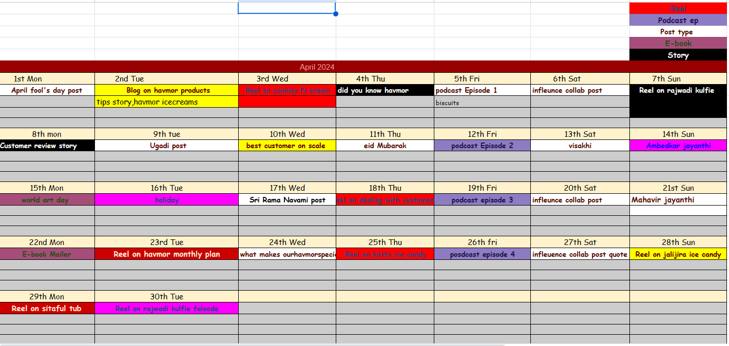
CONTENT CALENADER- 2024

Slide 26
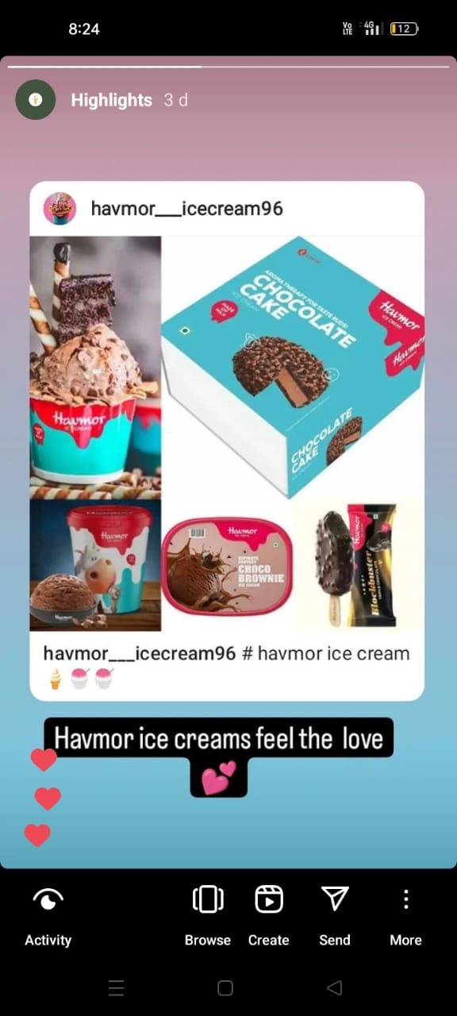
Strategy Aim and the Idea behind this story
Delicious Chocolate & cake ka
Perfect combo lekar aaye hai
Karna toh banta hai

Slide 27
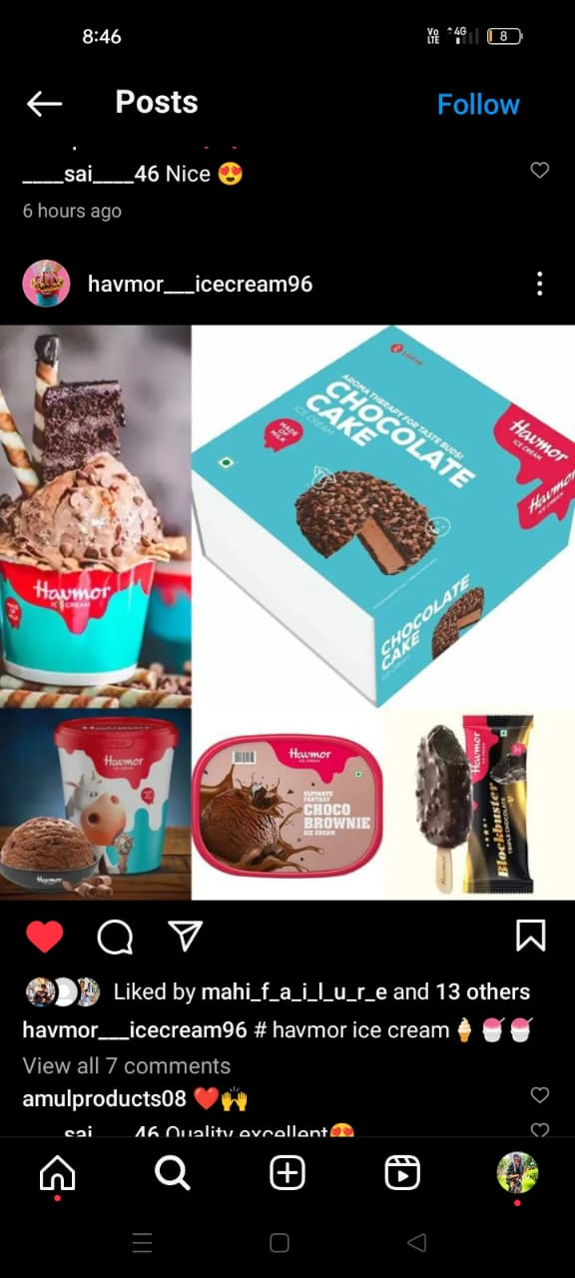
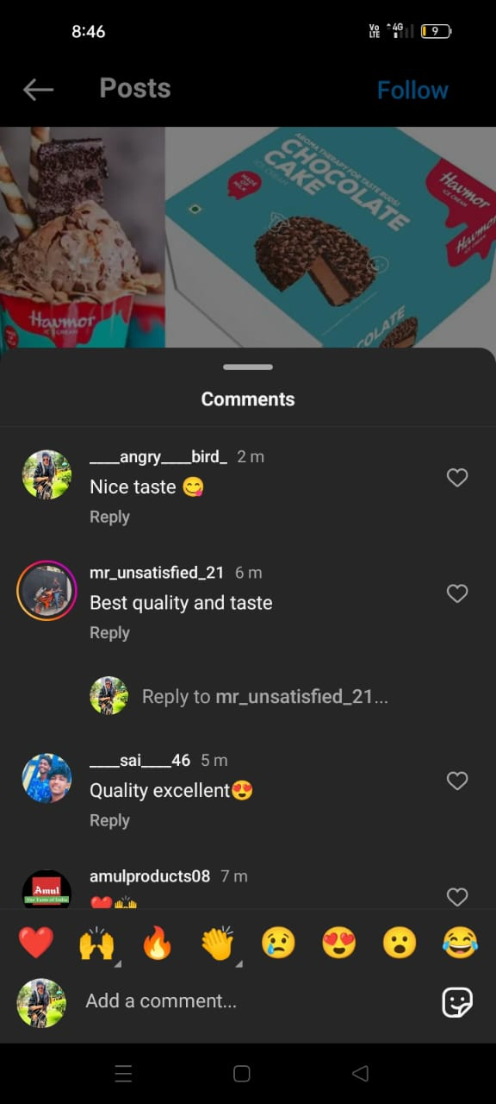
Strategy, Aim and the Idea behind this post
Satisfy your sweet cravings
With layers of velvety chocolate
Cake adorned with succulent
Strawberries and crowned with
Features a simple yet amazing
Chocolate cake.

Slide 28
Part 3: Content Ideas and marketing strategies
Havmor you could consider reaching out through their official website contact form social media platforms like Facebook or Twitter or even via email if you have a specific department or person in mind.
This could include hosting ice cream tasting sessions sponsoring community events or collaborating on limited-edition flavors. Summer promotion highlighting refreshing flavors or winter promotions focusing on warm treats like hot chocolate sundaes.
Develop an email newsletter for subscribers with updates on new flavors promotions and exclusive offers. Personalize content based on customer perferences and behavior.

Slide 29
PART 4 : Content Creation and Curation
Post Creation:
Select Content Categories: The Havmor Ice Creams Product Modal of development is highlight different flavors of Havmor ice cream, providing details on taste profiles and ingredients. Share recipes that incorporate Havmor ice cream as a key ingredient, such as milkshakes, sundaes, and ice cream cakes.
Format 1: Havmor ice creams
Format 2: Havmor chocolate cake
Format 3: Havmor blueberry cheese cake

Slide 30
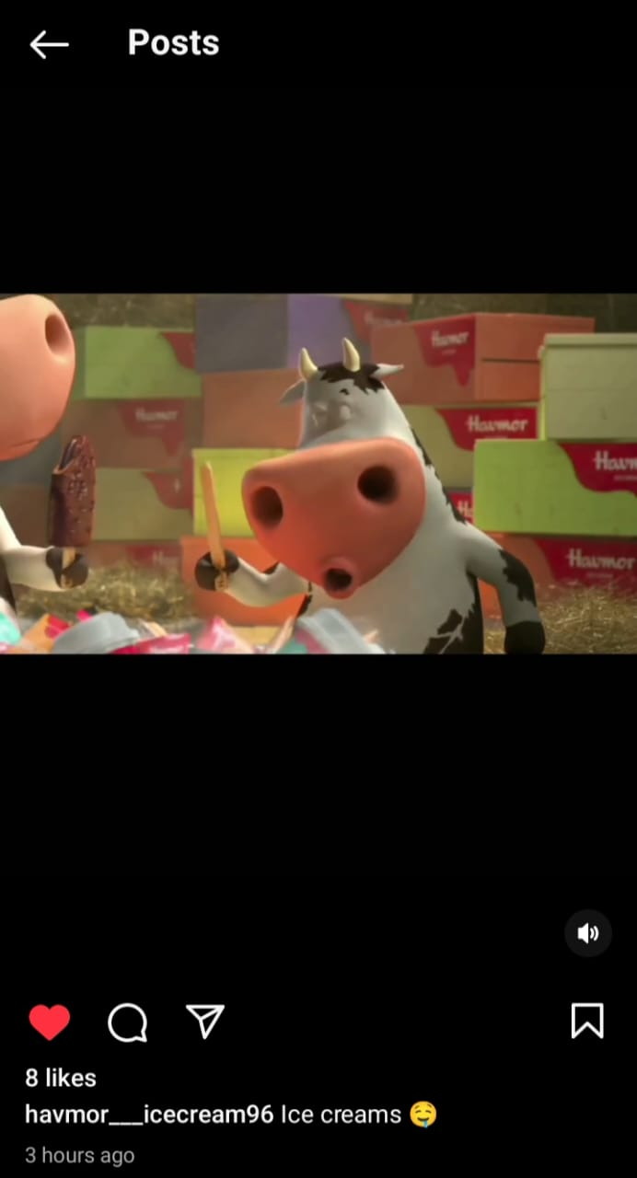
Format 1: Havmor ice creams
Caption: Isn’t eating world Havmor Ice cream easy, peasy, just open the cone effortlessly and lose yourself in its delicious taste.
Link: https://www.instagram.com/p/C6F9ub5Pr3i/?igsh=MXhqdXVyN2k1d3lrOQ==
Post:
Hashtags: #Havmor #Ice cream

Slide 31
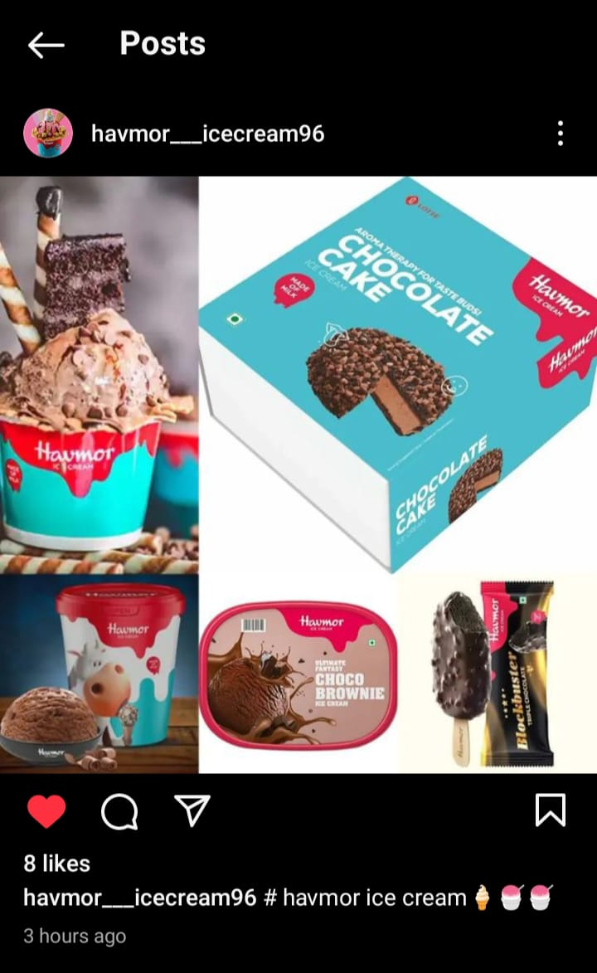
Format 2: Havmor Chocolate cake
Caption: If you’ve eaten Chocolate cake, you already know the answer and if not, stay turned to explore effortless ‘Easy Tear’ feature of this delicious cone.
Link: https://www.instagram.com/p/C6F9ub5Pr3i/?igsh=MXhqdXVyN2k1d3lrOQ==
Post:
Hashtags: #LOTTE #HavmorOnline

Slide 32
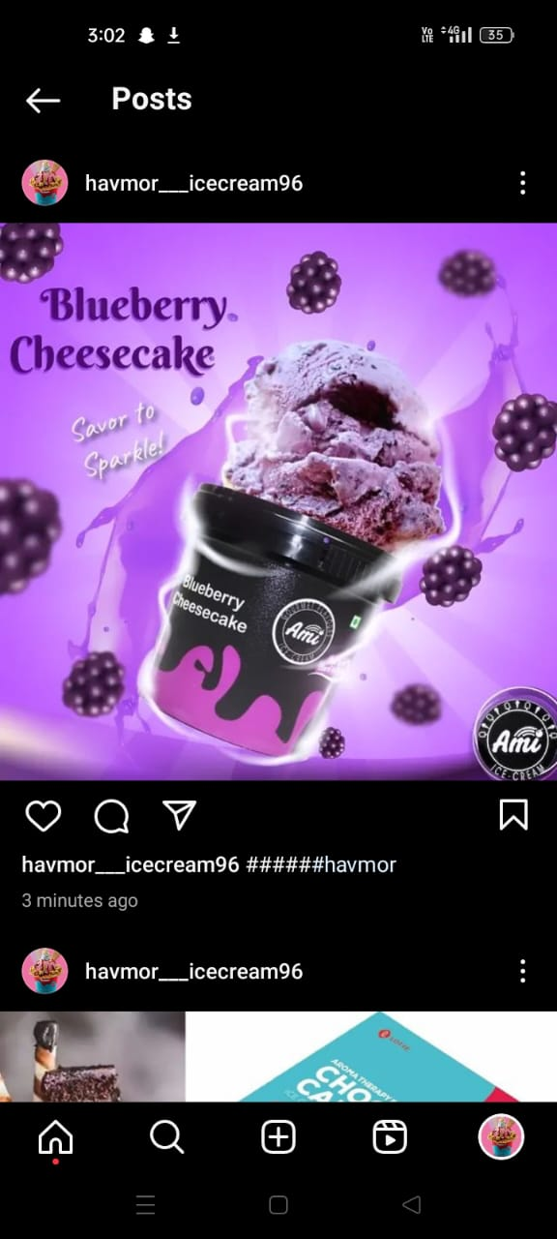
Format 3: Havmor Blueberry Cheesecake
Caption: Yehi hai woh Blueberry cheesecake our ice cream ka coolest combo, jo tumhara new favouirte banne wala hai
Link: https://www.instagram.com/p/C6OD6Pjv3Hi/?igsh=cTg3dzVkcXRvY2xs
Post:
Hashtags: #Blueberrycheesecake #havmoricecream

Slide 33
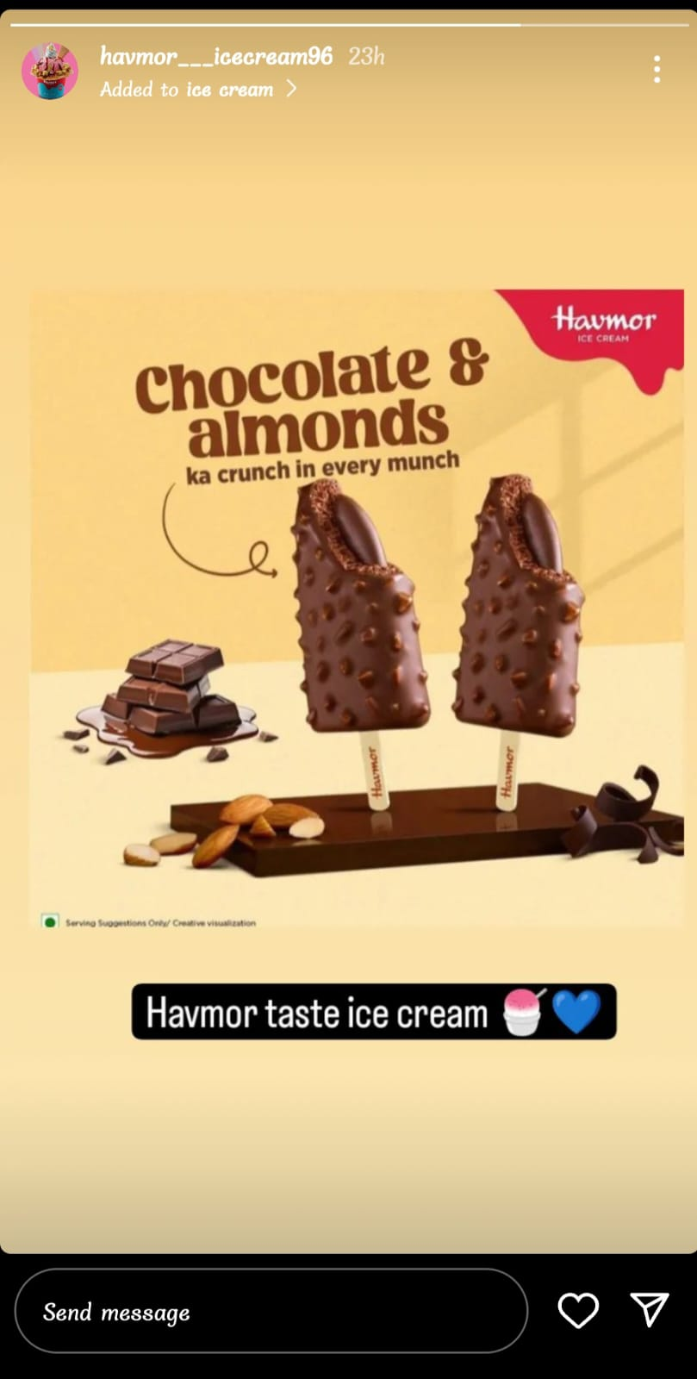
Instagram Story
Screenshots of story
https://www.instagram.com/stories/havmor___icecream96/3352407438115304506?utm_source=ig_story_item_share&igsh=MTl6NmQ2d3B4azh0dQ==

Slide 34
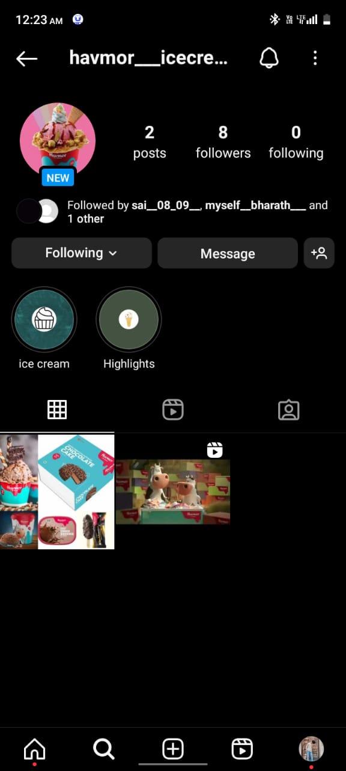
HighLights for Story
https://www.instagram.com/s/aGlnaGxpZ2h0OjE4MDIzMTk5OTcxMTI1OTMx?story_media_id=3352359489754645034_66247047869&igsh=ZmsybHFrZnFmMWgx

Slide 35
Story Insights – Q&A
Reach is 250
Impressions is 755
Like is_________
Etc……
Area for improvement:
The product Havmor Ice Cream they could focus on introduce new and unique flavors or product variations to cater to changing consumer.
Customer experience enhance the overall customer experience by improving service quality, ambiance in stores and online ordering convenience.

Slide 36
Part 4: Content Creation and Curation
Designs/Video Editing
Designs Tools for Content creation and curation use Canva app for making photos editing.
Video Creation : The video Tools Inshort Video Editing App for makeing creativity video.

Slide 37
THANK YOU

